Slide 1
Kernel SVM
Non Parametric, Binary Classification Technique

Slide 2
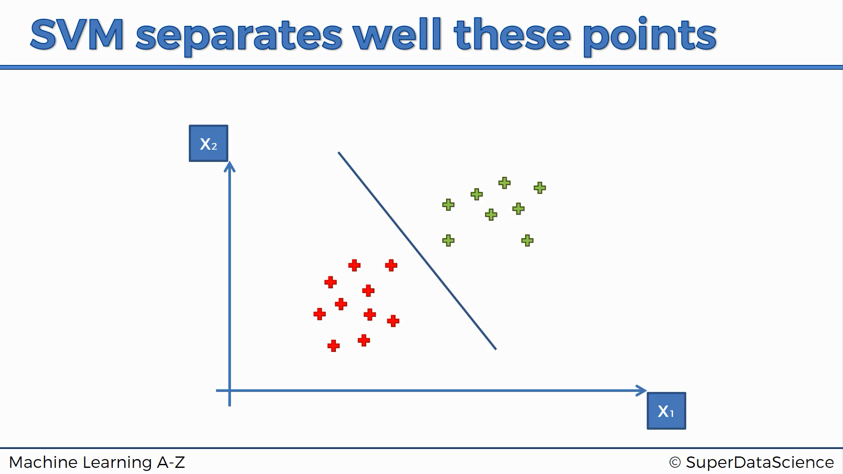

Slide 3
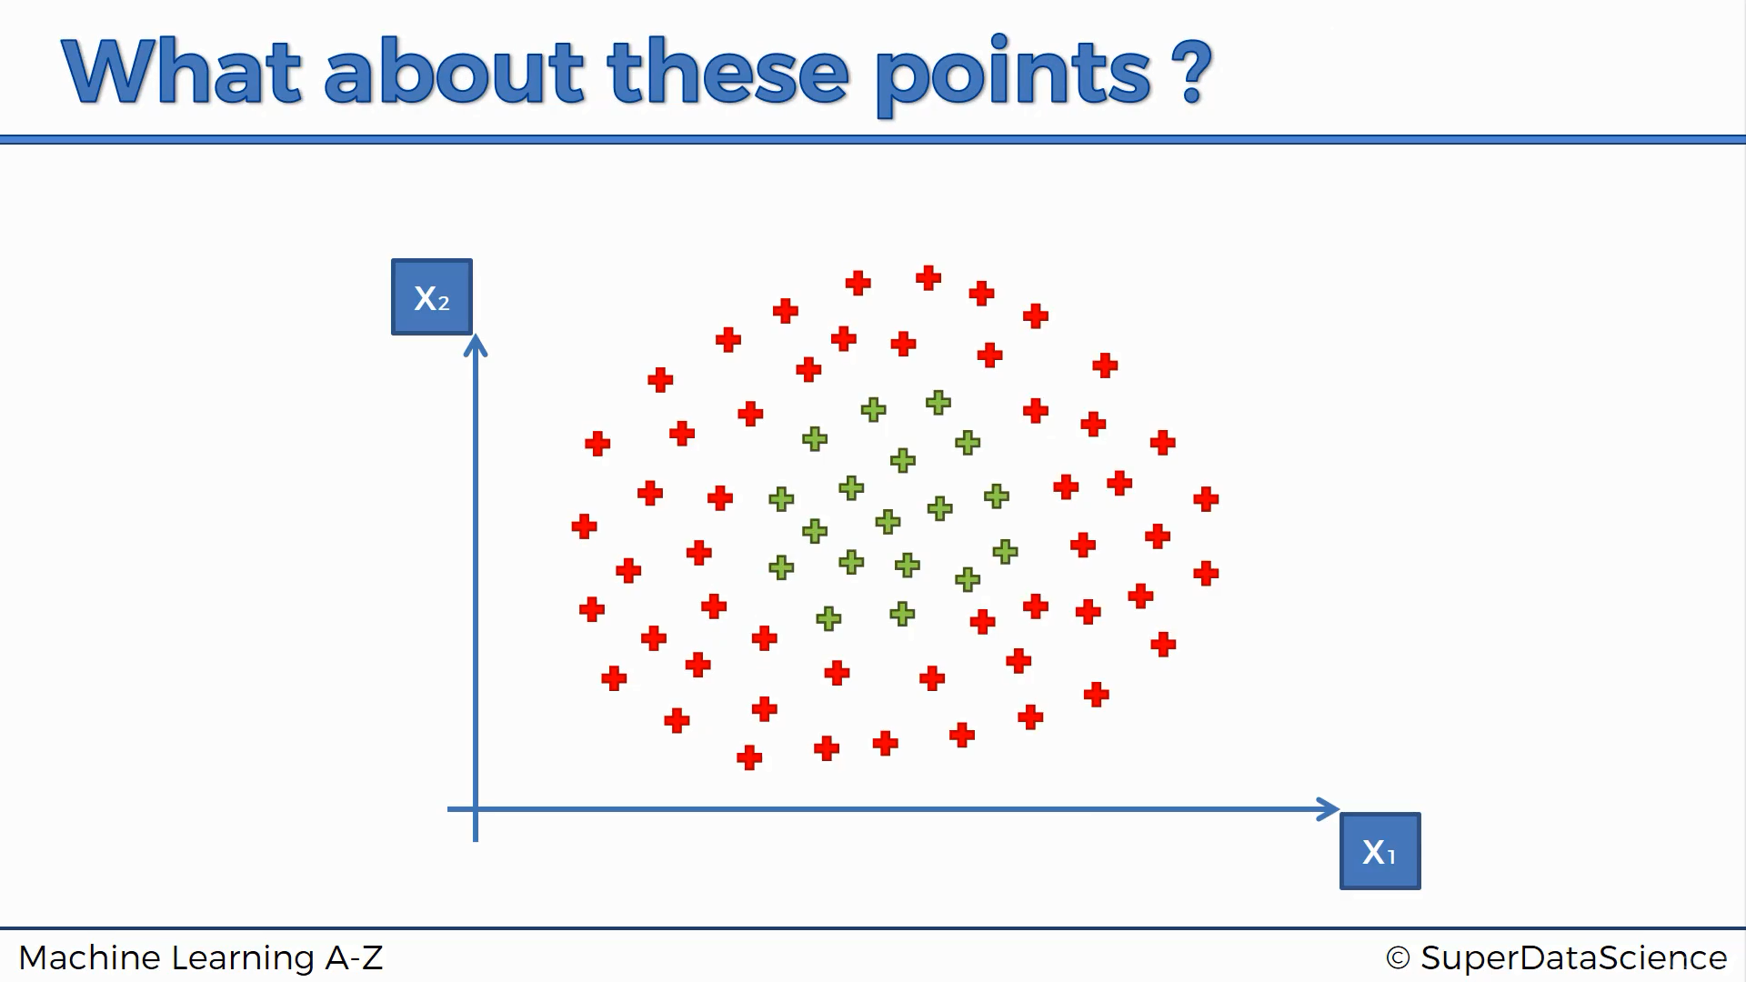
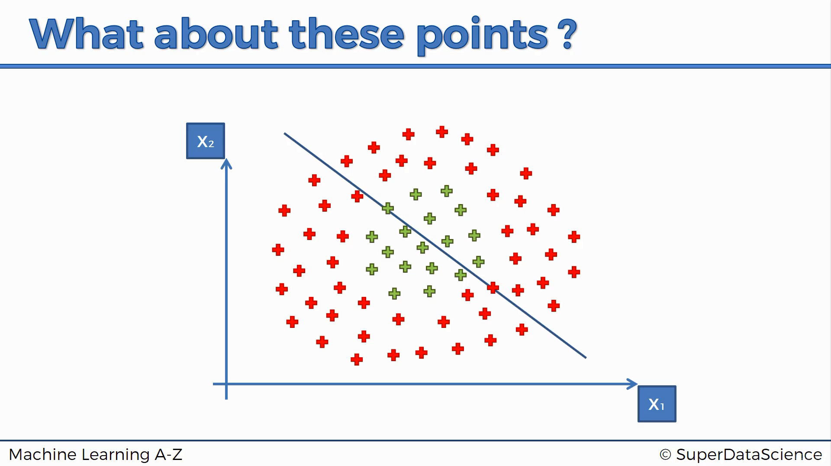

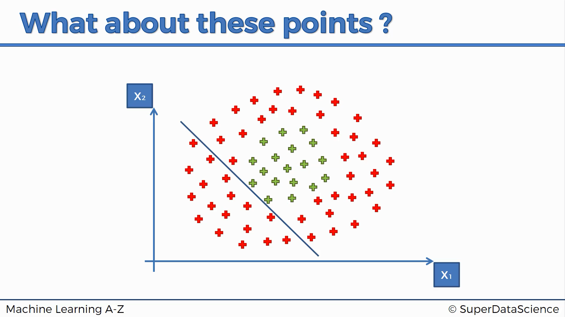

Slide 4
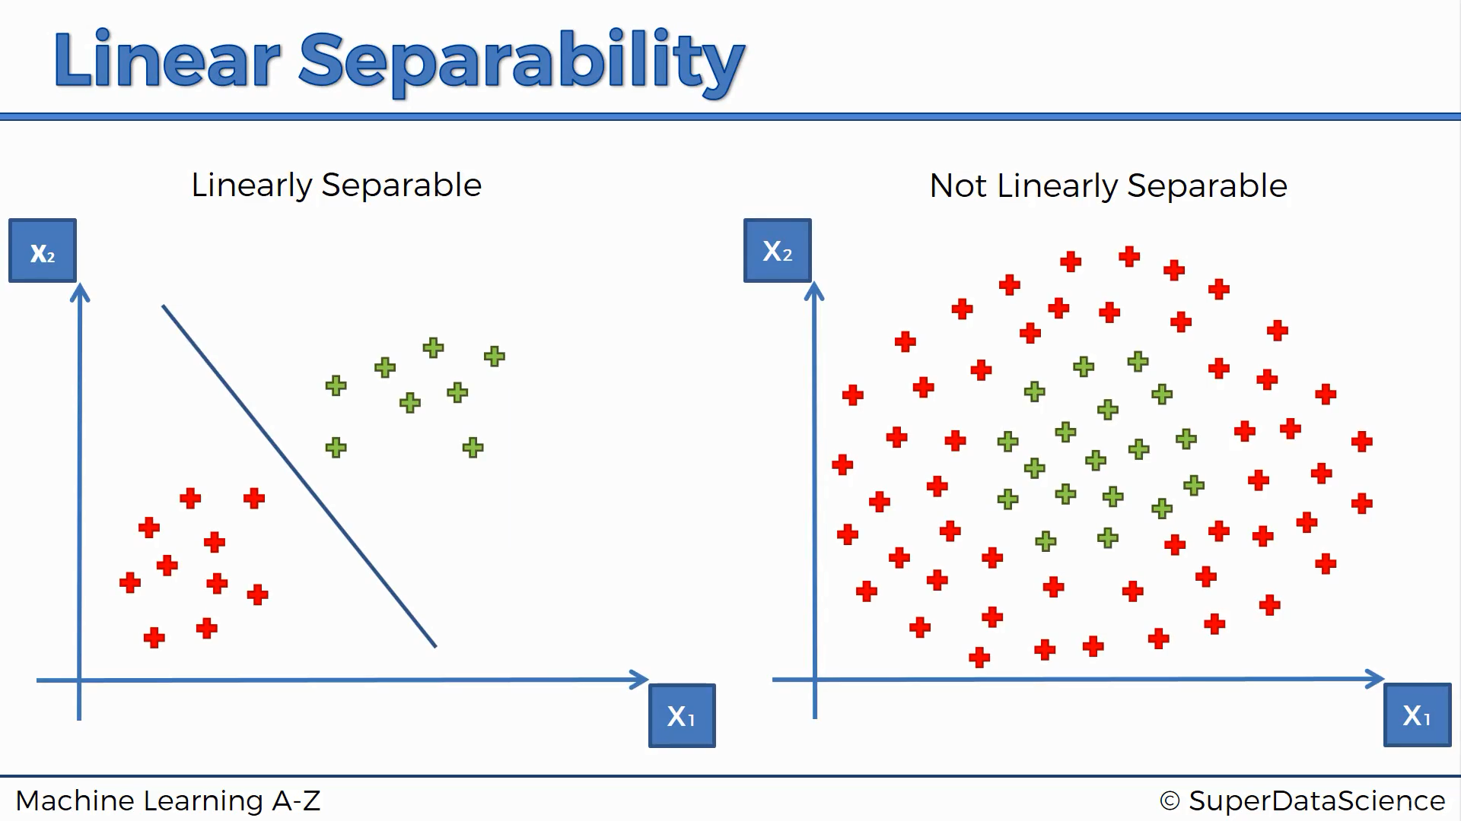

Slide 5
Let’s talk about 1-D data
How do we classify Non-Linearly separable data in one dimension

Slide 6
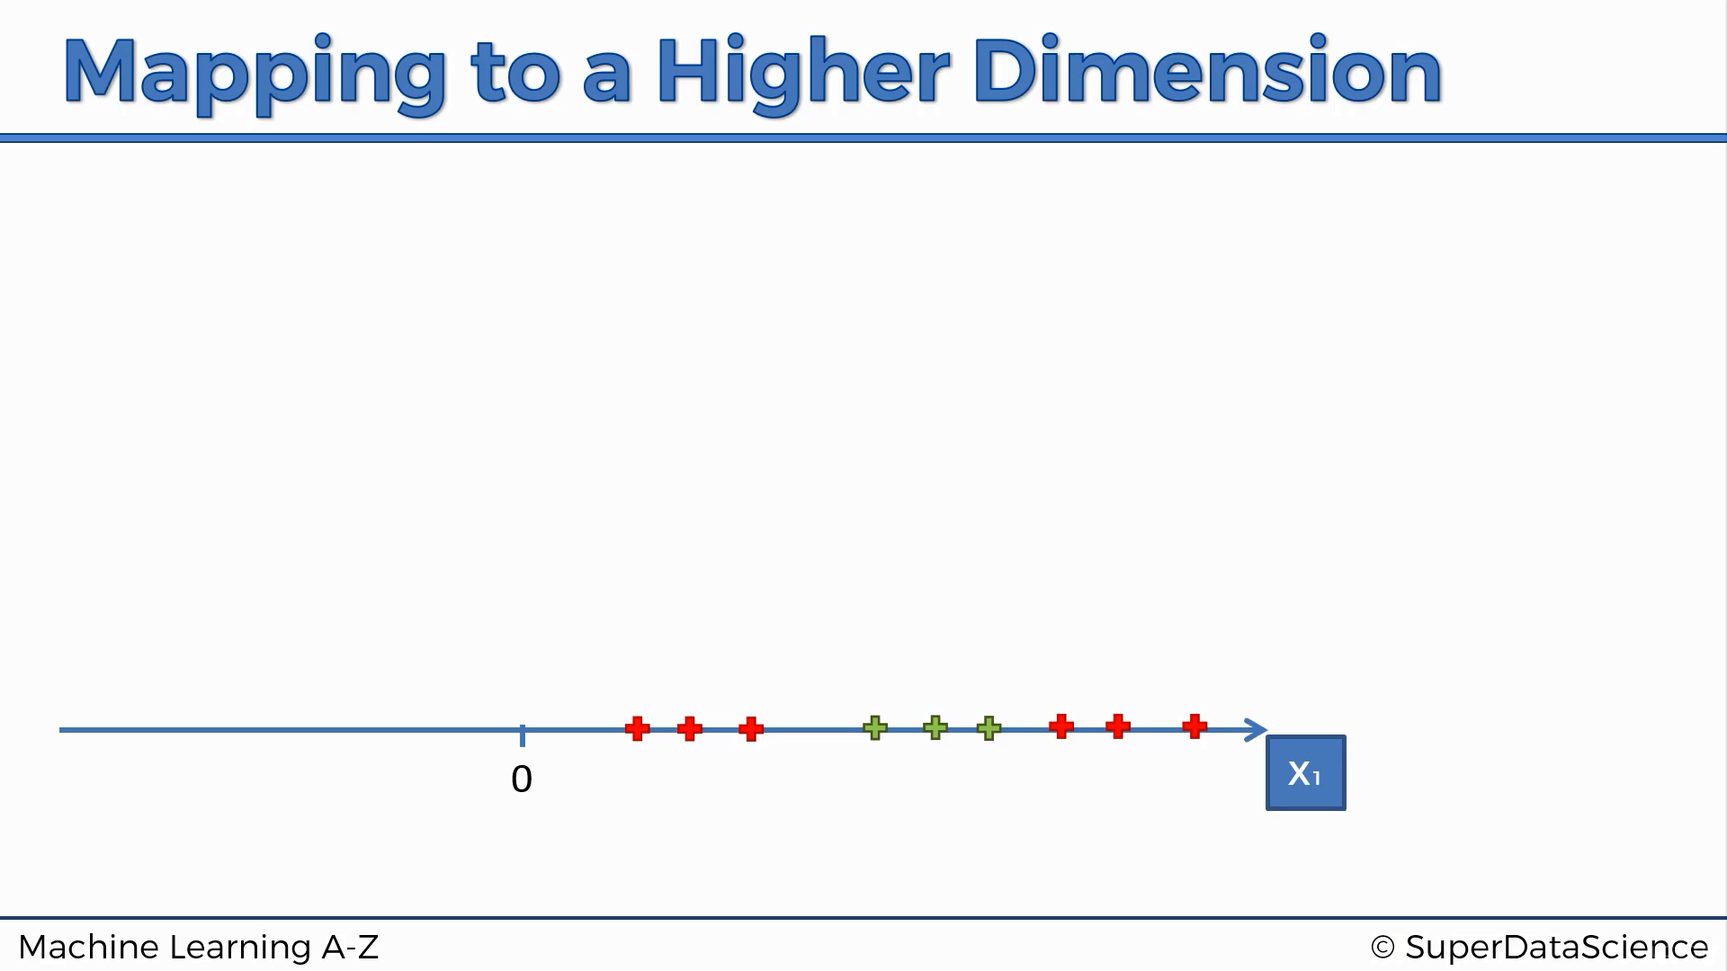

Slide 7
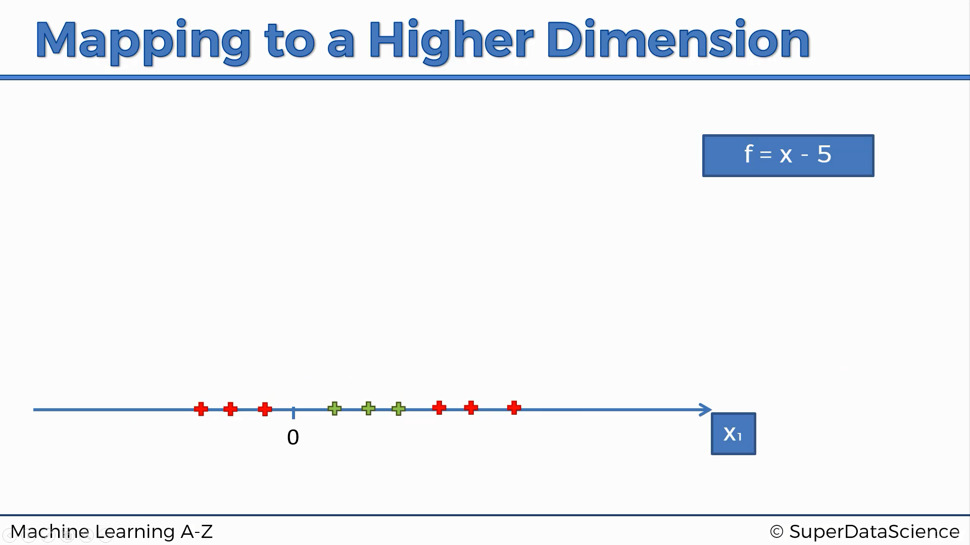

Slide 8
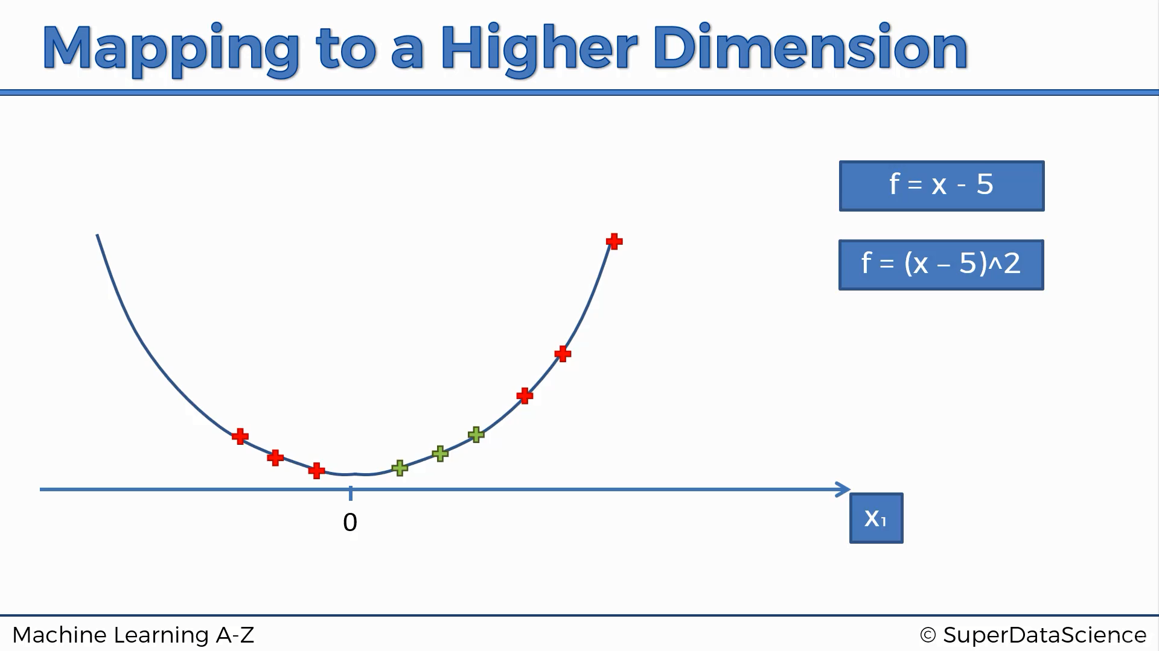

Slide 9
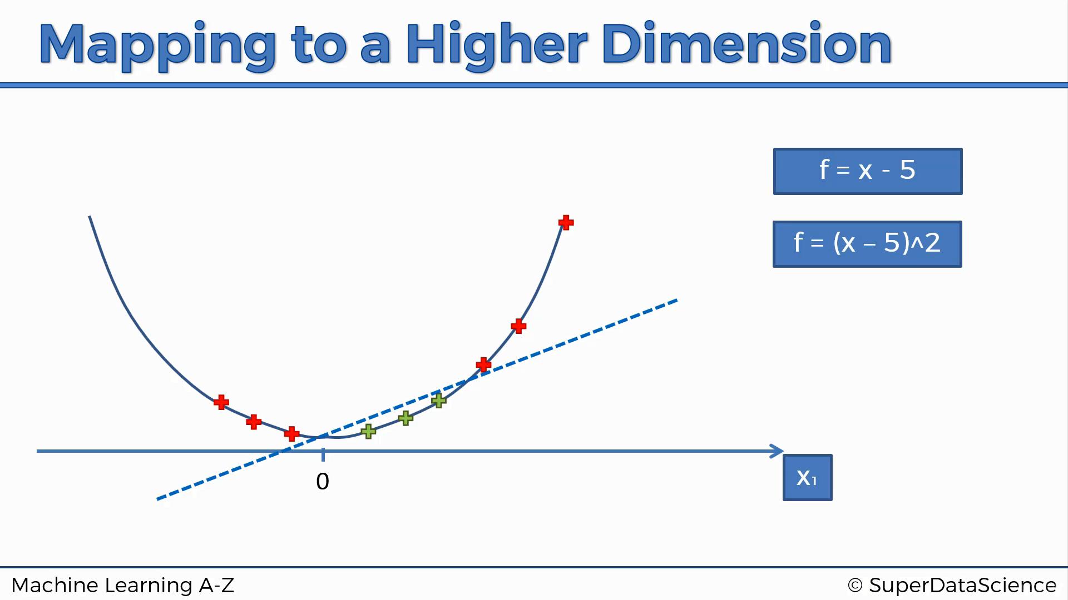

Slide 10
How about 2-D data
Classifying non–linearly separable data in two dimensions

Slide 11
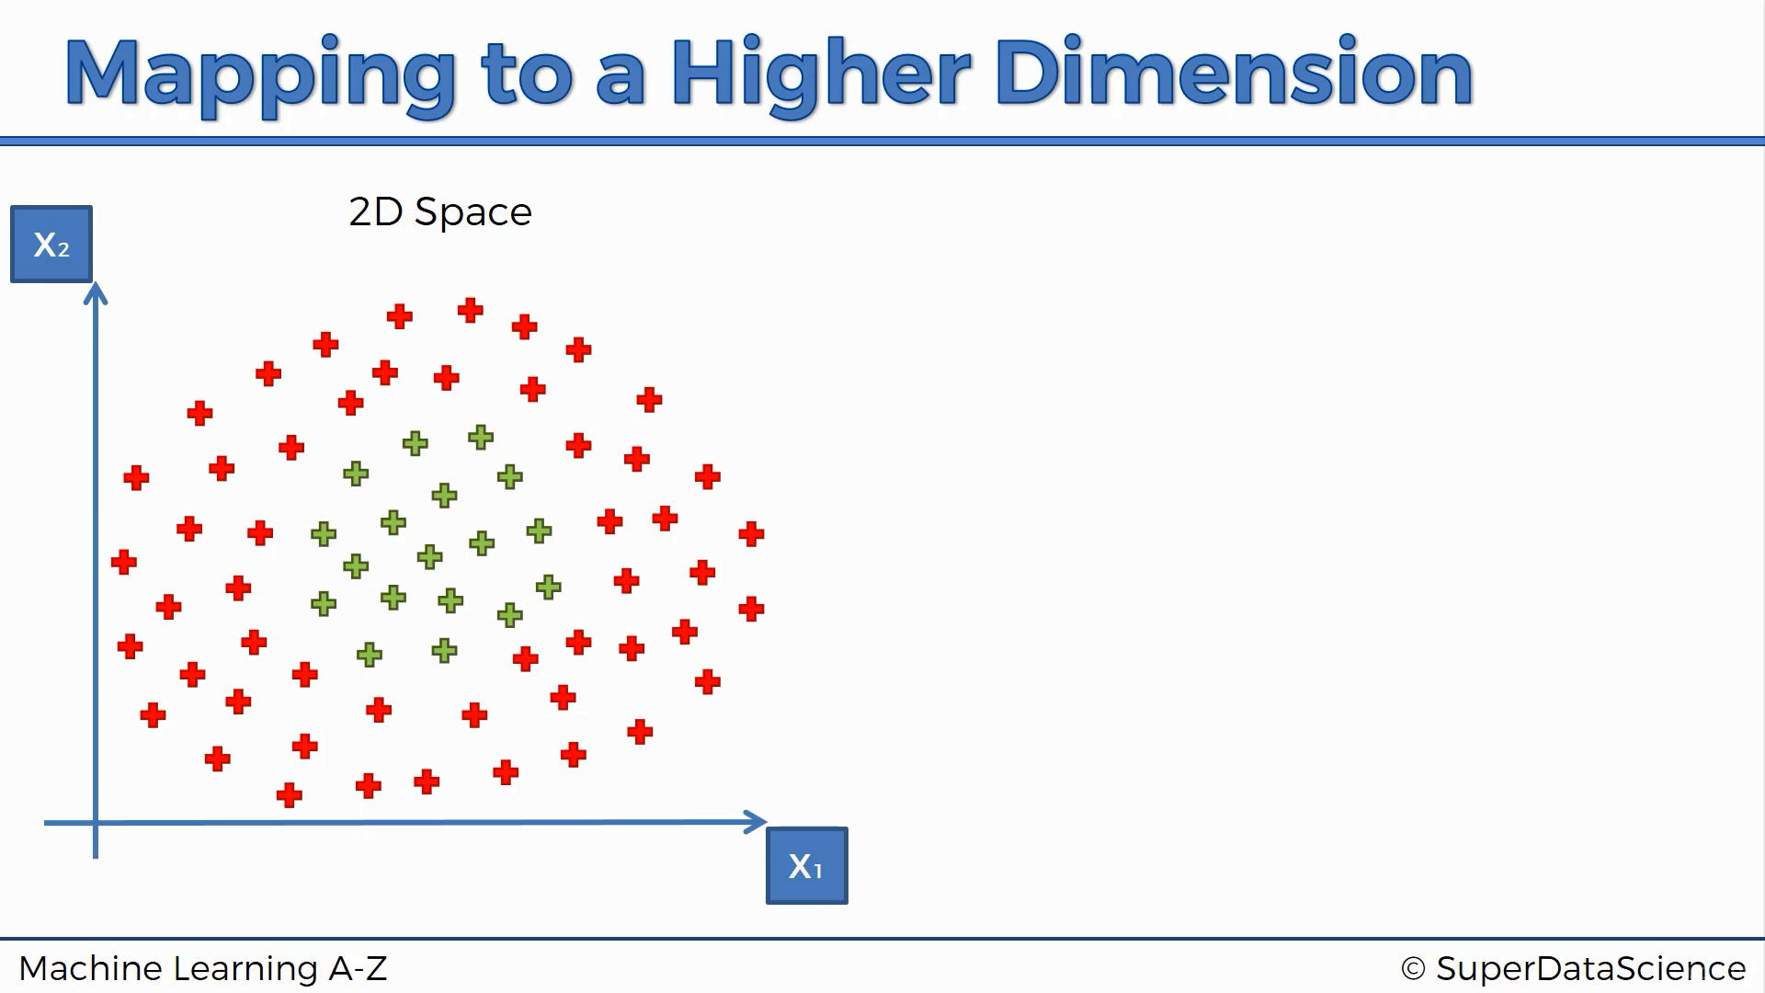

Slide 12
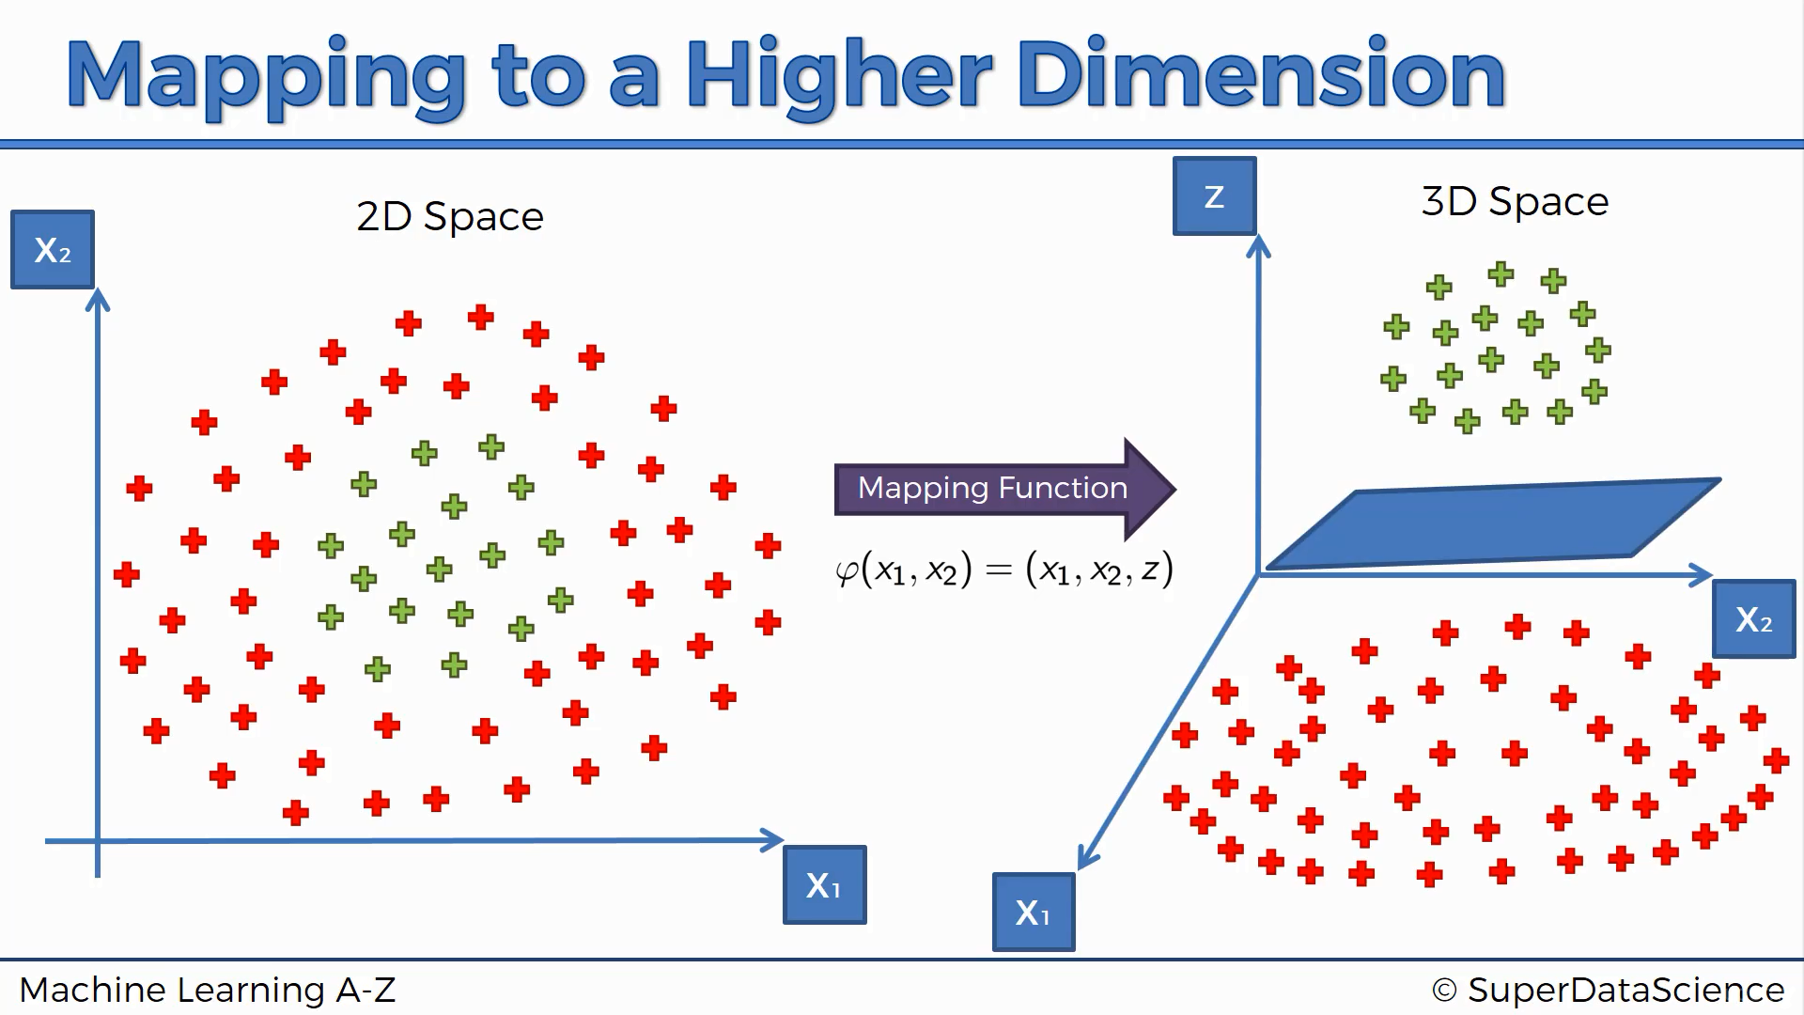


Slide 13
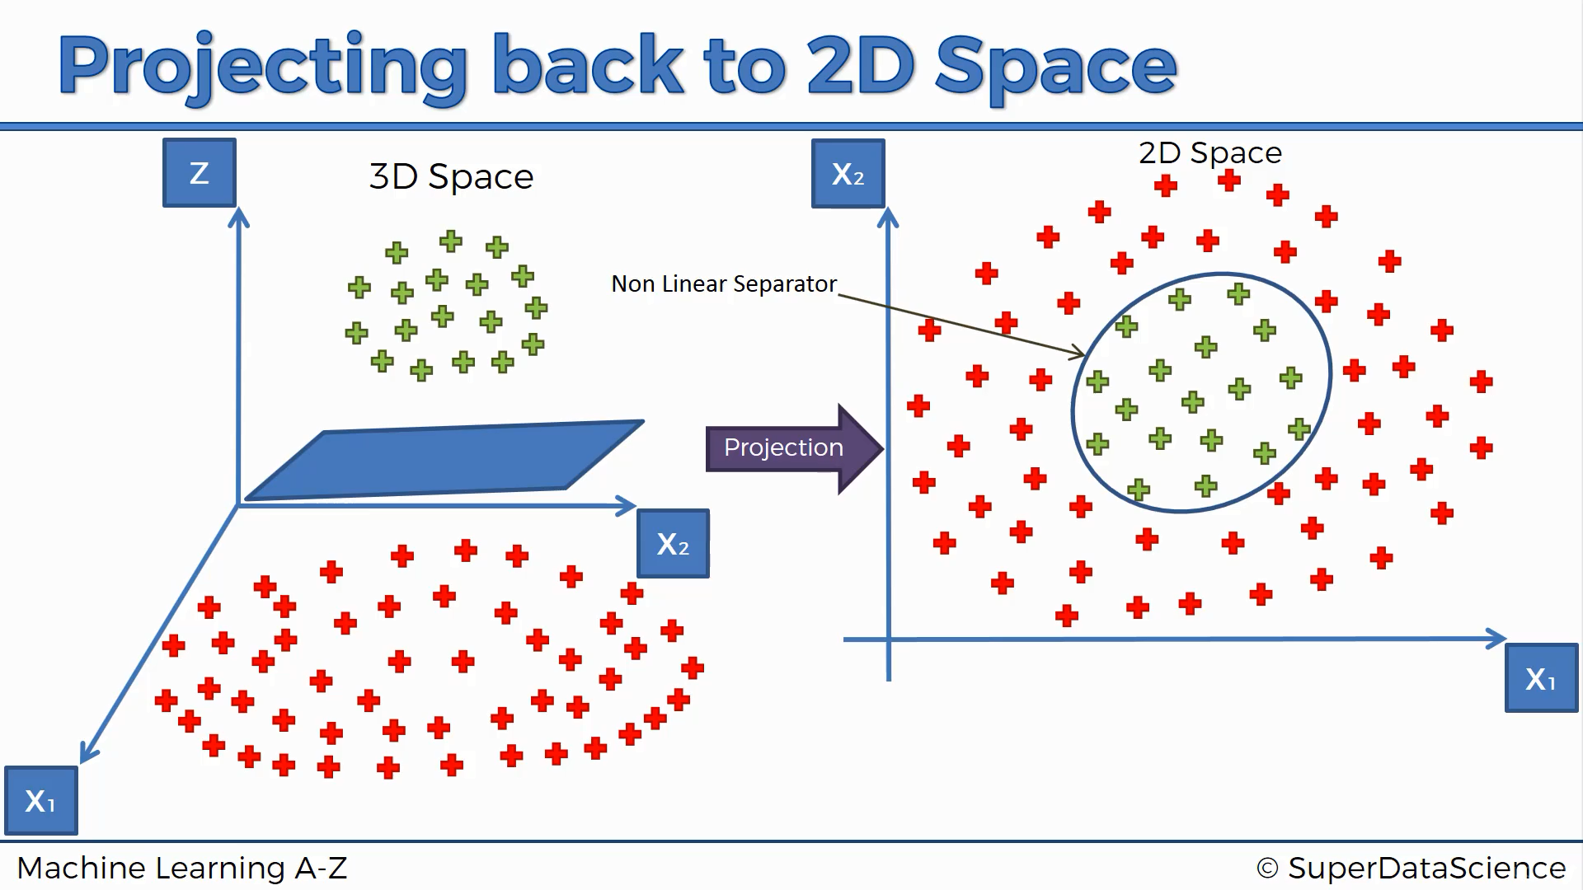

Slide 14
Challenges
Mapping to a higher dimension can’t always be visualized
Mapping to a higher dimension is highly computation-intensive

Slide 15
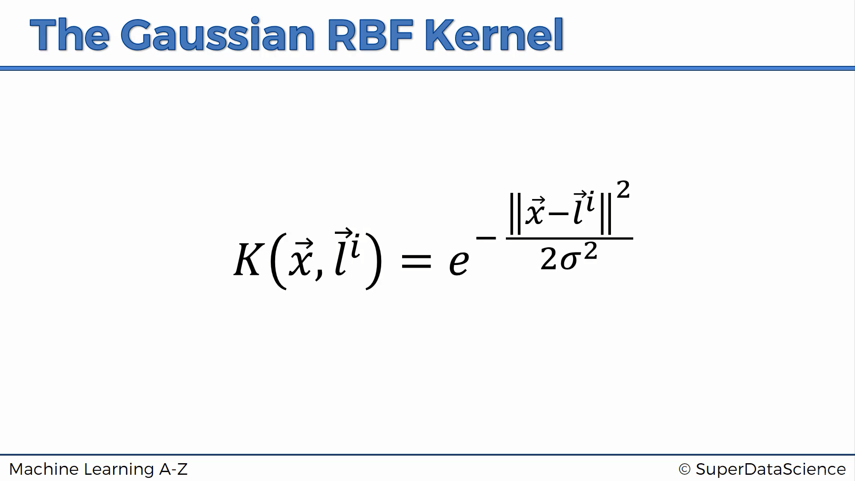

Slide 16
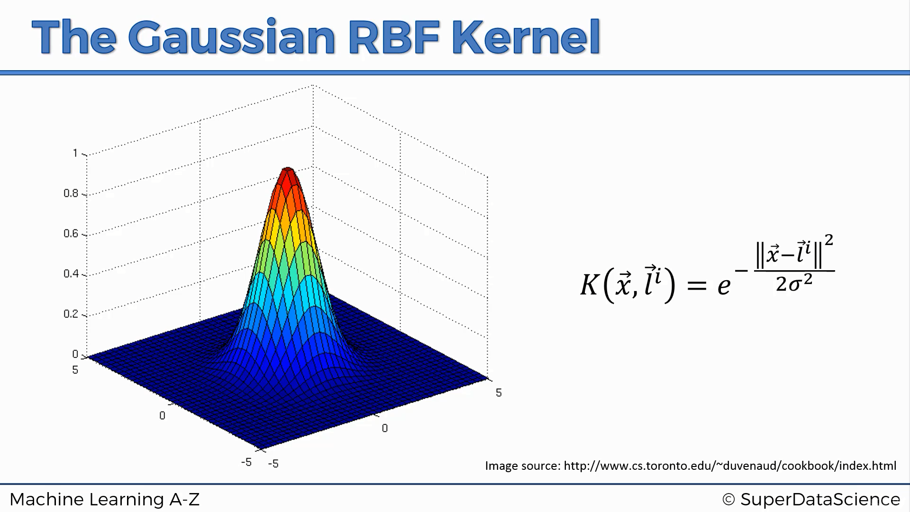

Slide 17
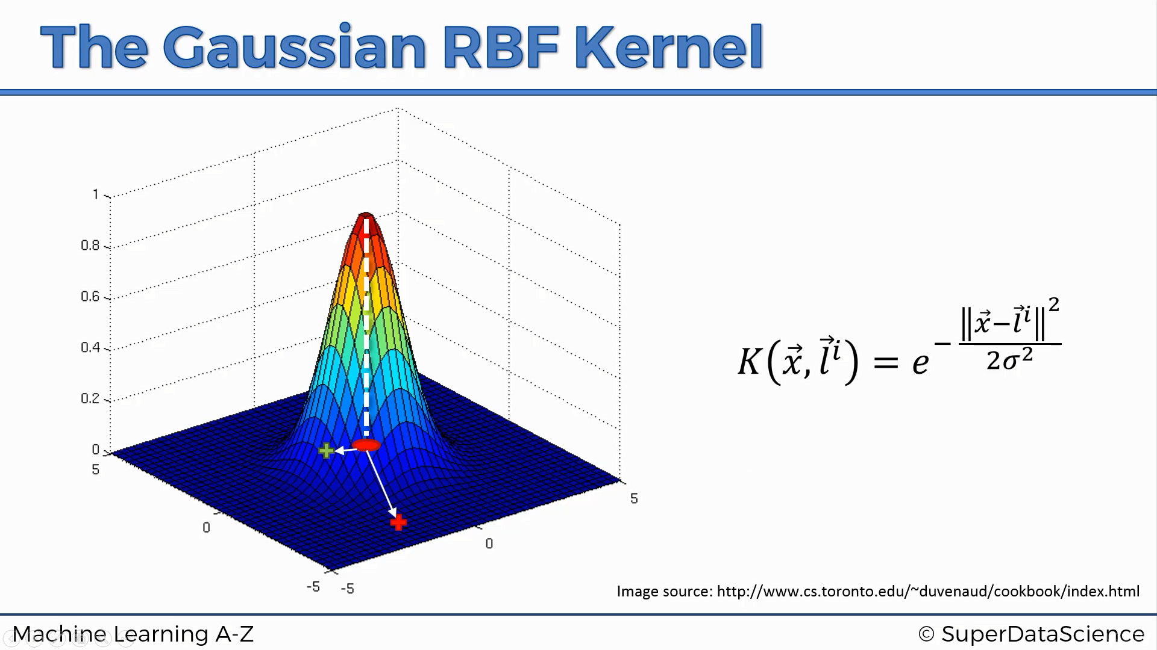

Slide 18
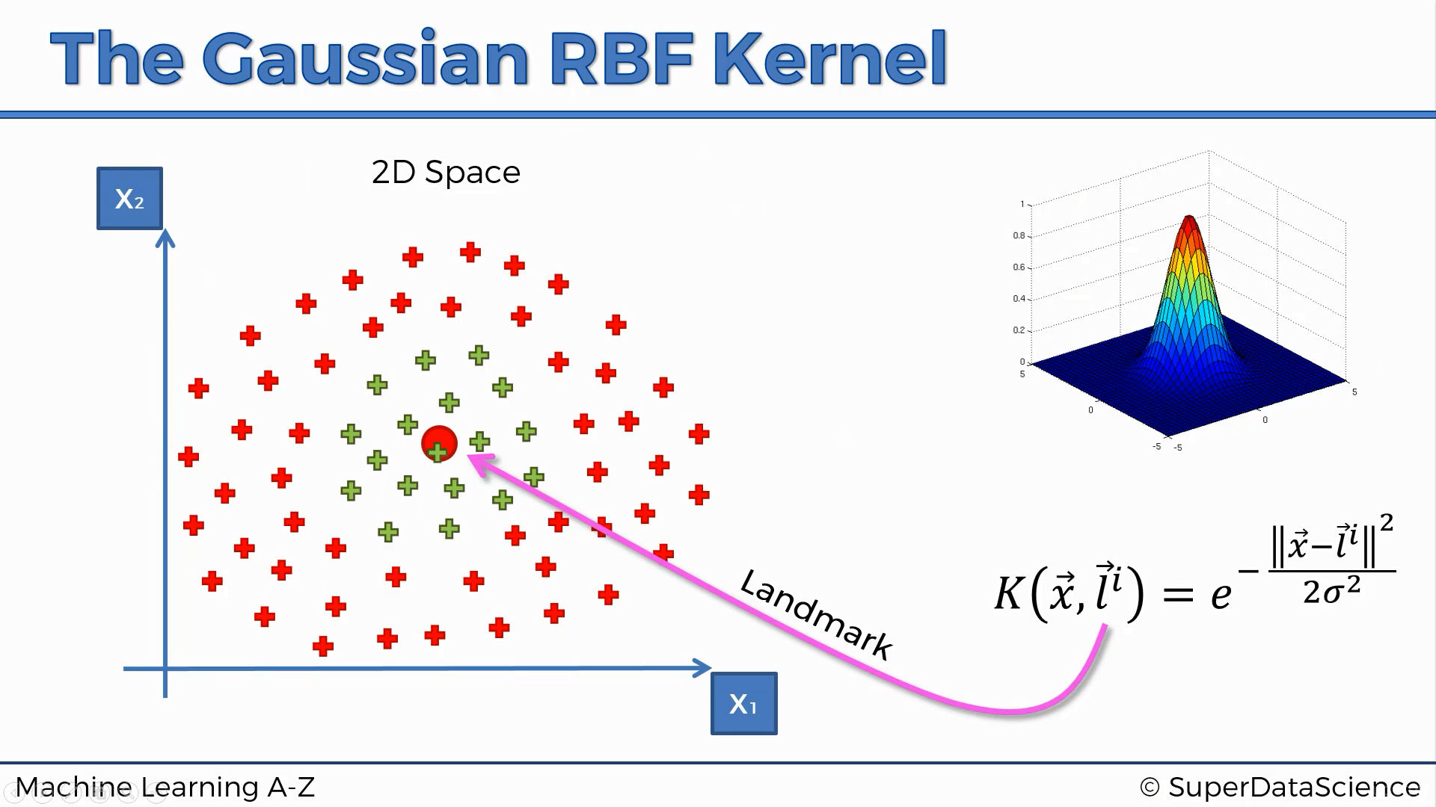

Slide 19
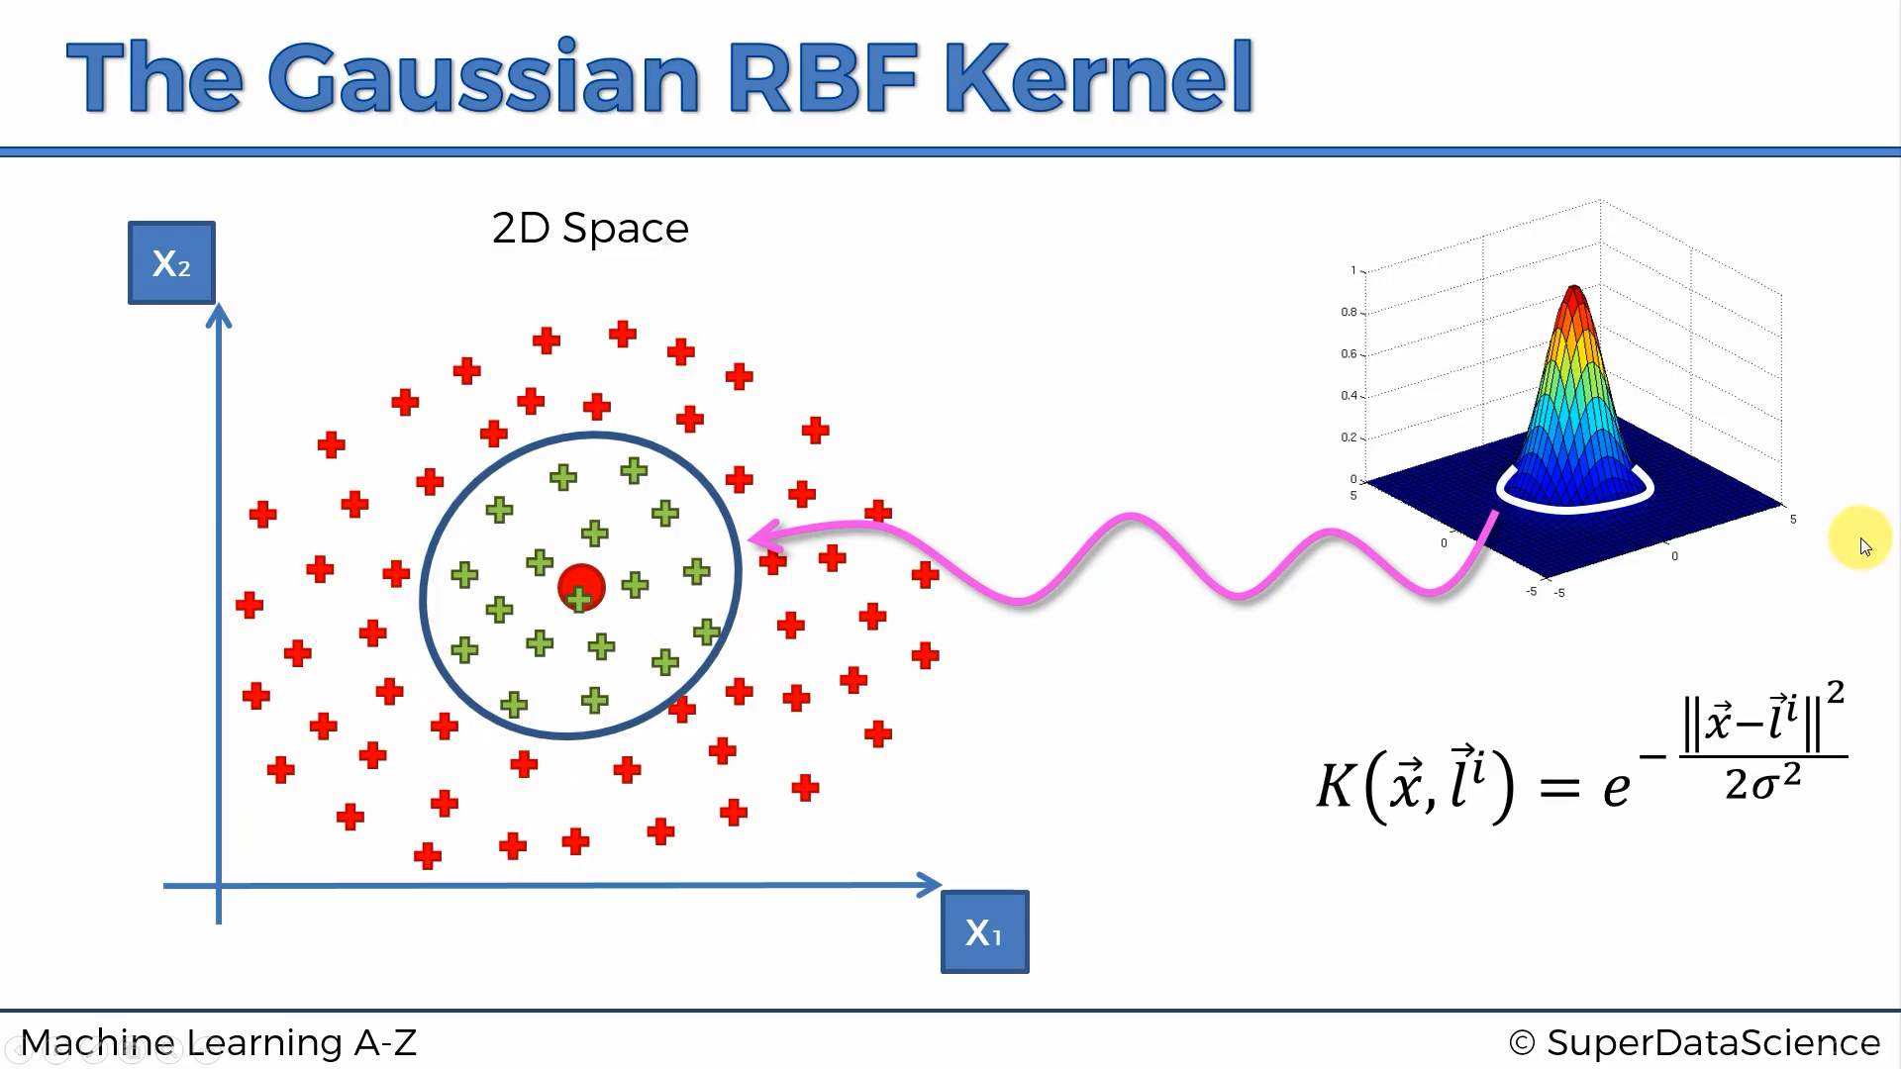

Slide 20
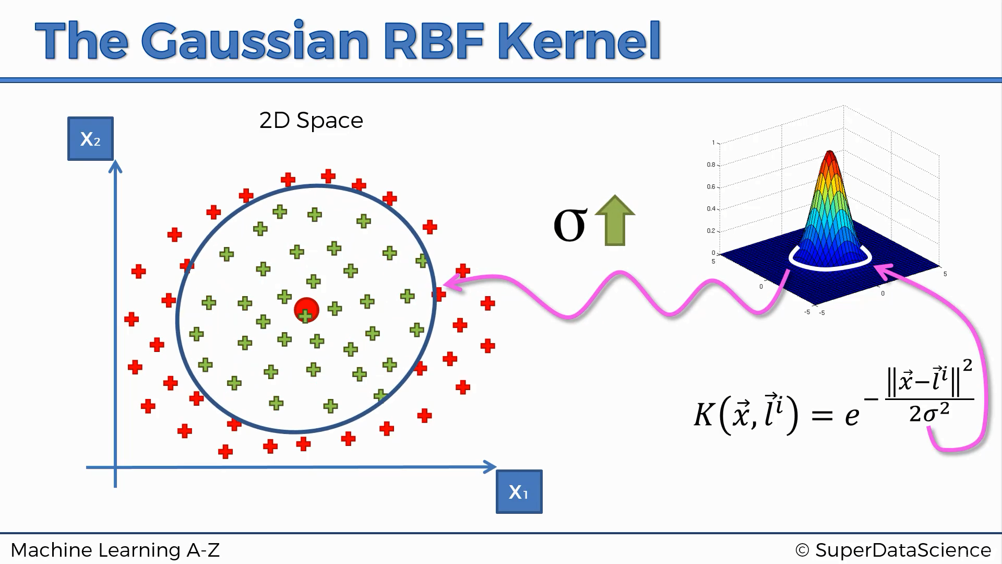

Slide 21
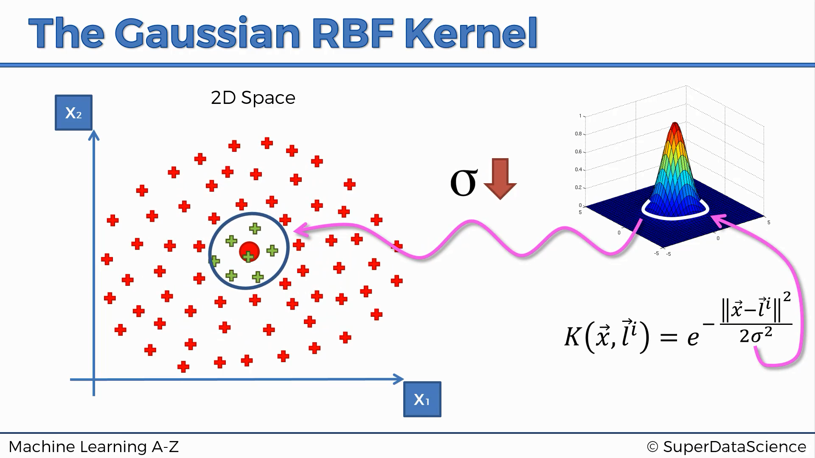

Slide 22
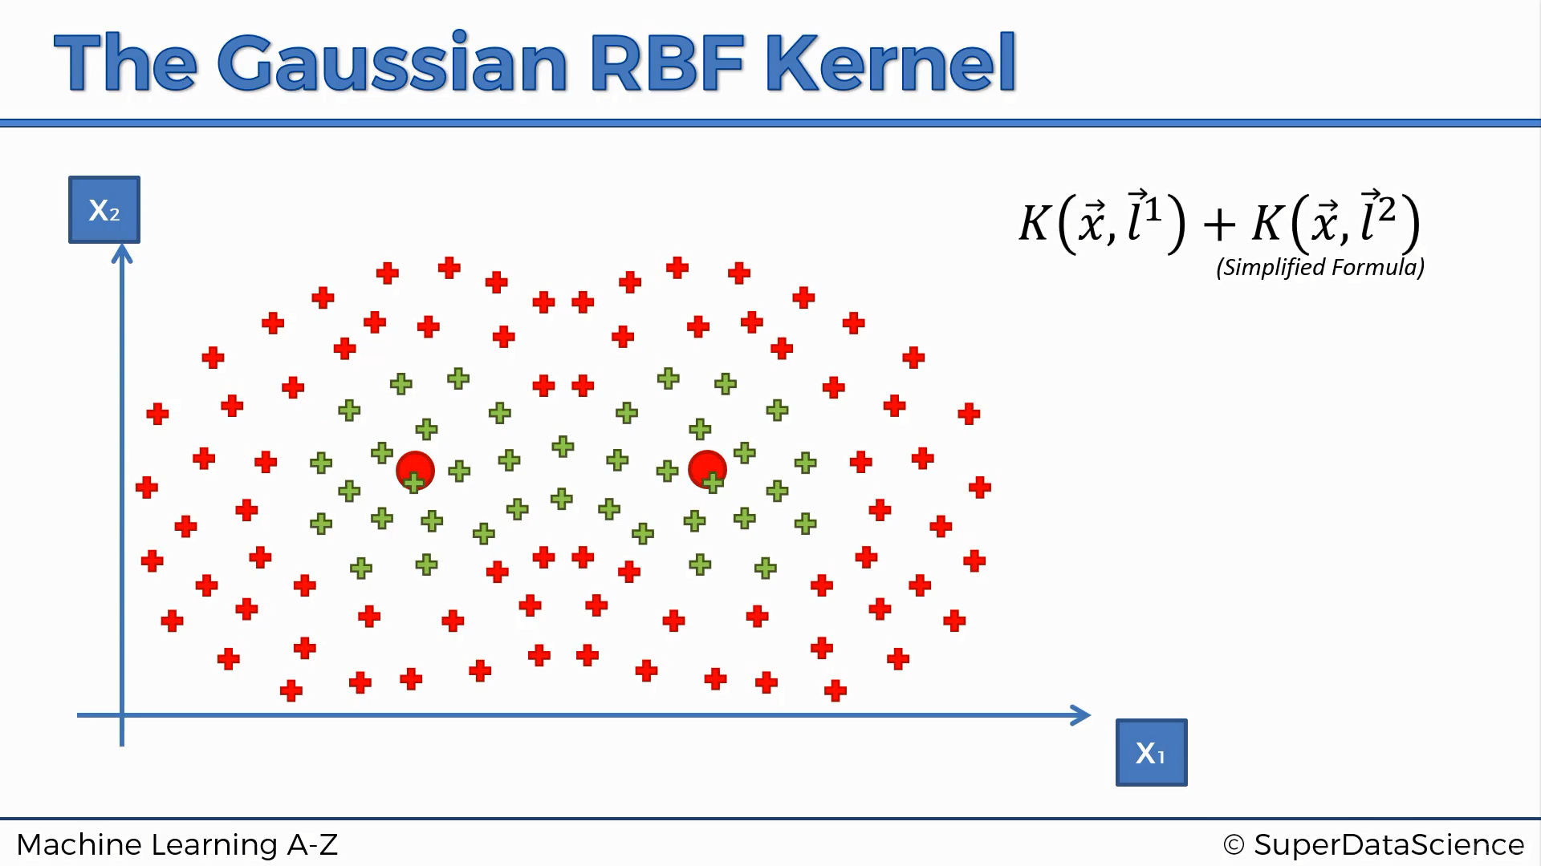

Slide 24
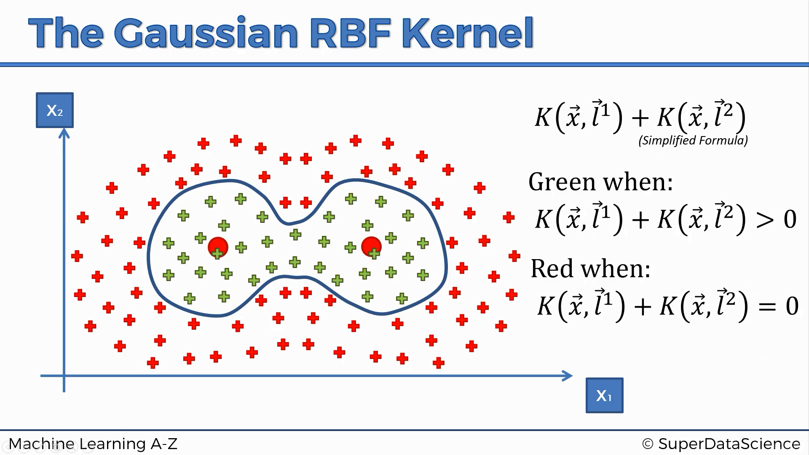

Slide 25
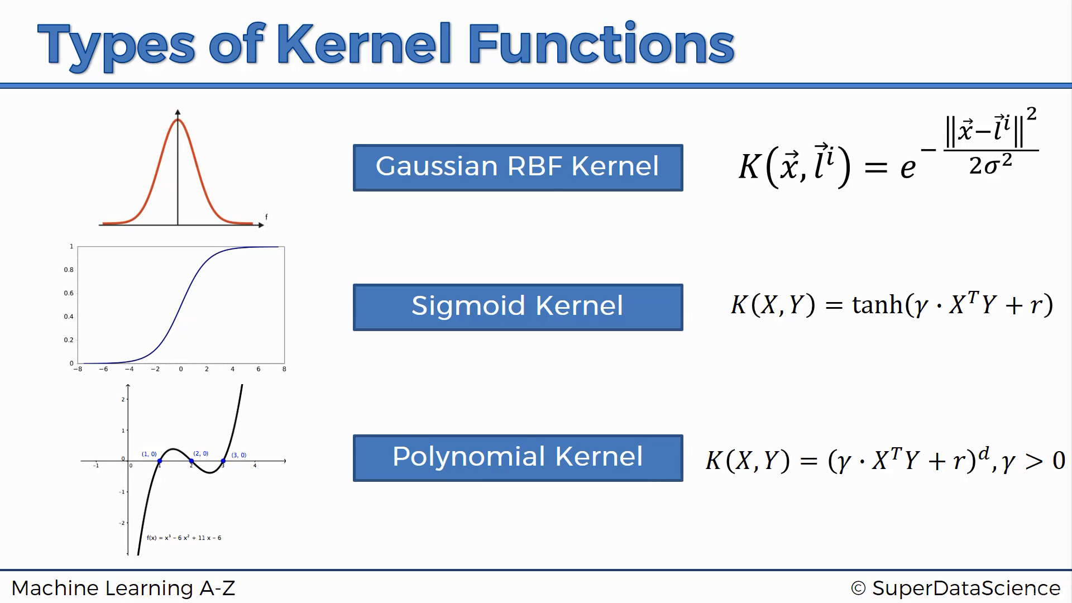

Slide 26


Data Preparation
Numerical Inputs: SVM assumes that your inputs are numeric. If you have categorical inputs you may need to covert them to binary dummy variables (one variable for each category) using One-Hot Encoding.
Binary Classification: SVM is intended for binary (two-class) classification problems.

Slide 27
Model Tuning
Tuning SVM Parameters to obtain better results.

Slide 28
Regularization (C Parameter)
The Regularization parameter (often termed as C parameter in python’s sklearn library) tells the SVM optimization how much you want to avoid misclassifying each training example.
For large values of C, the optimization will choose a smaller-margin hyperplane if that hyperplane does a better job of getting all the training points classified correctly.
Conversely, a very small value of C will cause the optimizer to look for a larger-margin separating hyperplane, even if that hyperplane misclassifies more points.

Slide 29
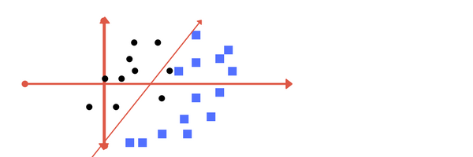
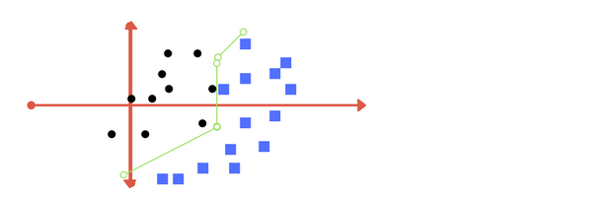
Low Regularization (C) value
Higher Regularization (C) value

Slide 30
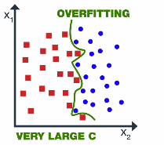
If the value of C is large then model choose more data points as a support vector and we get the higher variance and lower bias, which may lead to the problem of overfitting.

Slide 31
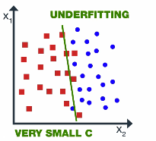
If the value of C is small then model choose fewer data points as Support Vector and get lower variance / High Bias.

Slide 32
Gamma
The gamma parameter defines how far the influence of a single training example reaches, with low values meaning ‘far’ and high values meaning ‘close’.
For lower gamma value, the points far away from plausible separation line are considered in calculation for the separation line.
Higher gamma means the points close to plausible line are considered in calculation.

Slide 33
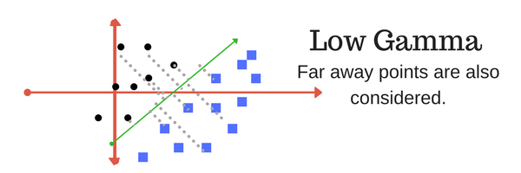
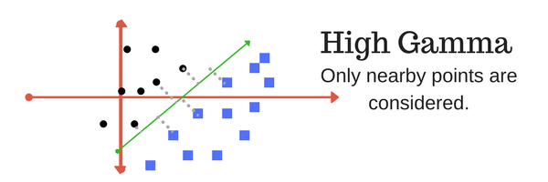

Slide 34
Advantages
It works really well with clear margin of separation
It is effective in high dimensional spaces
It is effective in cases where number of dimensions is greater than the number of samples
It uses only a subset of training points in the decision function (called Support Vectors), so it is also memory efficient

Slide 35
Disadvantages
It doesn’t perform well, when we have large data set because the required training time is higher
It also doesn’t perform very well, when the data set has more noise i.e. target classes are overlapping
SVM doesn’t directly provide probability estimates, these are calculated using an expensive five-fold cross-validation. It is related SVC method of Python scikit-learn library.

Slide 36
Further Reading on Kernels
http://mlkernels.readthedocs.io/en/latest/kernels.html

Slide 37
Python’s sklearn Documentation
http://scikit-learn.org/stable/modules/svm.html
http://scikit-learn.org/stable/modules/generated/sklearn.svm.SVC.html

